Slide 1
The people who cast the votes don't decide an election, the people who count the votes do. Joseph Stalin, Premier of the Soviet Union

Slide 2
Koenig on November 4, 2022:
Praying what happened with the Brazilian vote in October 2022 won’t happen in the U.S. While millions of Republicans were working hard to get out the vote, billions of dollars was spent, the voting machine fraudsters were planning their electronic election manipulation.
Vote fraud has been successful in two of the largest countries in the world

Slide 3
US Midterm Election – Nov. 8, 2022

Slide 4
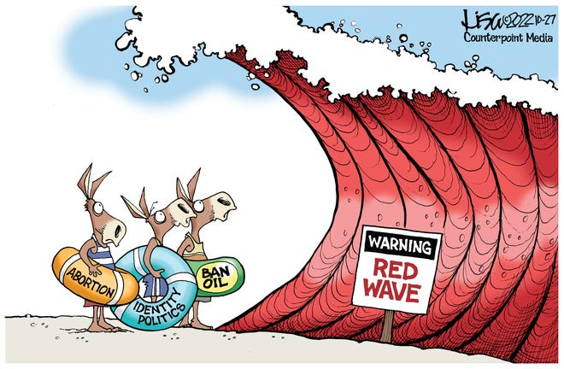
What happened to the red wave?

Slide 5
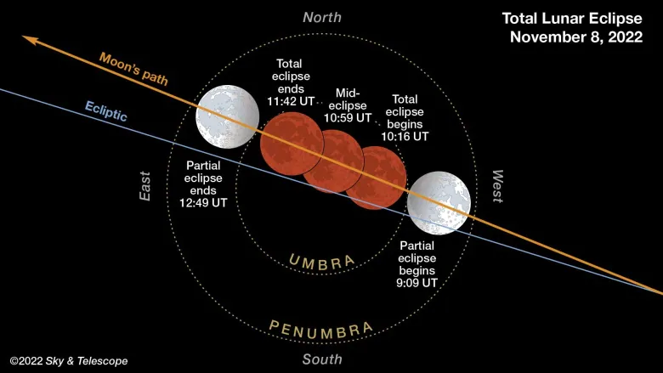
November 7–8, 2022 Total Lunar Eclipse (Blood Moon)
4:09 am to 11:42 am Washington, D.C. time

Slide 6
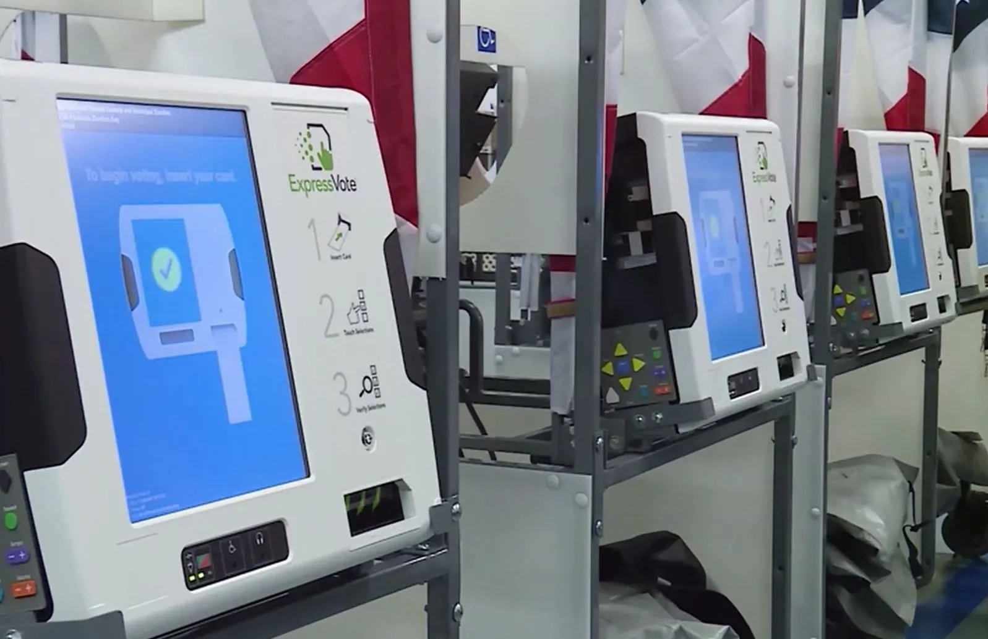
Questions about the 2022 Midterm Election
Red wave didn’t happen. Why?
Unpopular Biden (9/+2) successful midterm where Clinton (52/8), Bush (30/6), Obama (63/6) and Trump (40/+2) had big losses Voting machine manipulation – sophisticated. Is it becoming stealth?

Slide 7
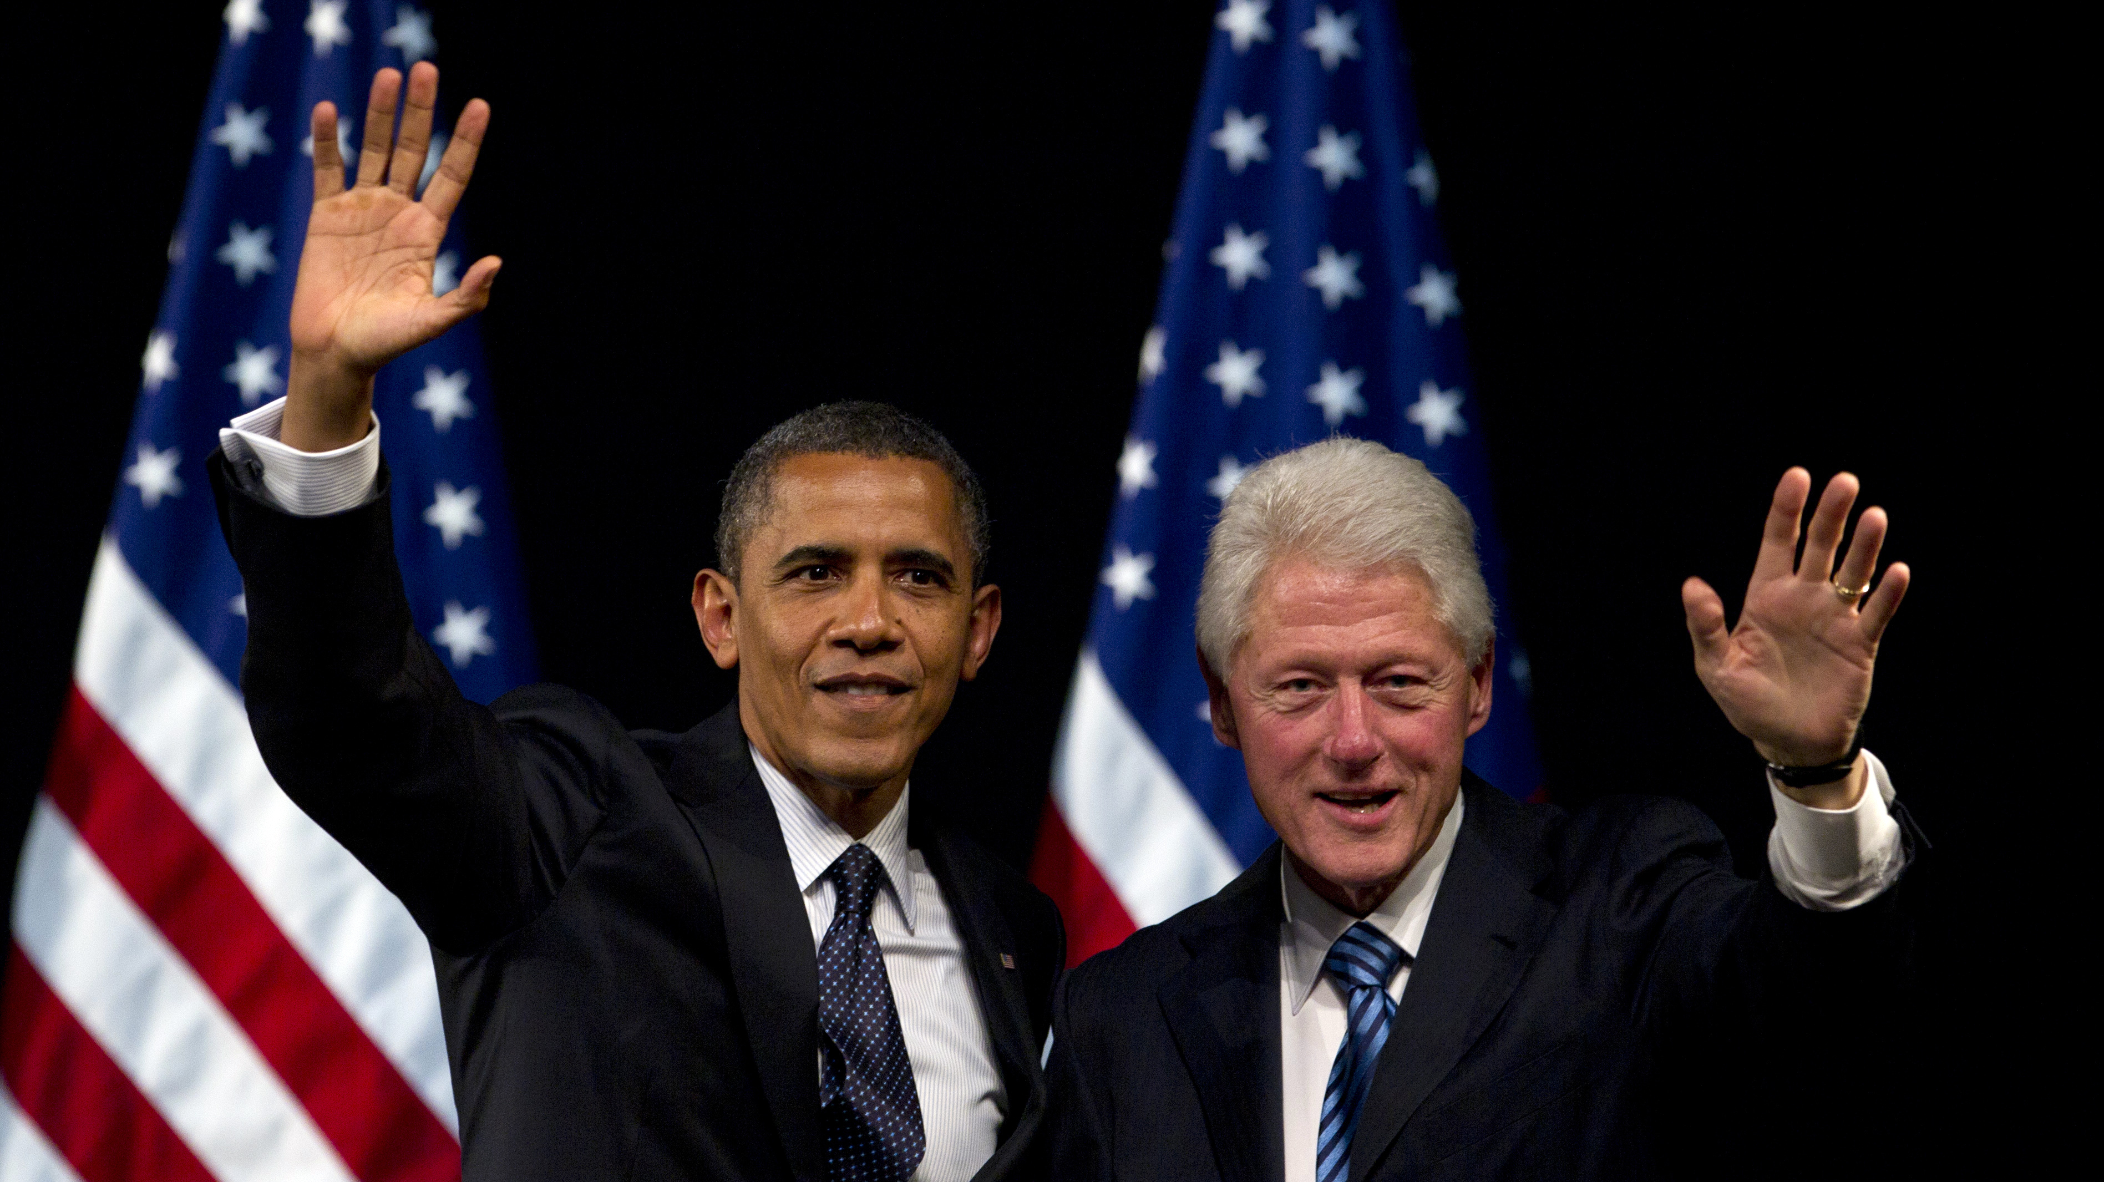
Was Civil War Spared?
Clintons, Obama, Biden said the future of America’s democracy is at risk because of a possible major Republican victory.
Mainstream media commentators especially MSNBC and CNN called Republicans fascist.
Democrats thought they could win with abortion, LGBTQ and critical race theory. Polls showed those issues low on the voter’s mind, but it was just enough votes to win close races.

Slide 8
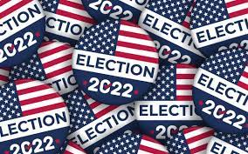
Today’s Democratic Party
Party of abortion, LGBTQ agenda and grooming, same-sex marriage, gender confusion, critical race theory, lawlessness, climate control lunacy, open borders, fiscal irresponsibility, absurd coronavirus vaccination requirements and lockdowns, allowing Chinese influence, speak divisive rhetoric and much more.
Furthermore, we are a constitutional republic, not a democracy.

Slide 9
31 Items in the Democratic Platform and agenda that are in direct opposition or violation of the Bible
Two main platform items:
Abortion and LGBTQ
---
Progressive control has been disaster

Slide 10
LGBTQ Disruption – Judgement
Nothing more divisive
After children - grooming
Social networks
Mainstream media

Slide 11
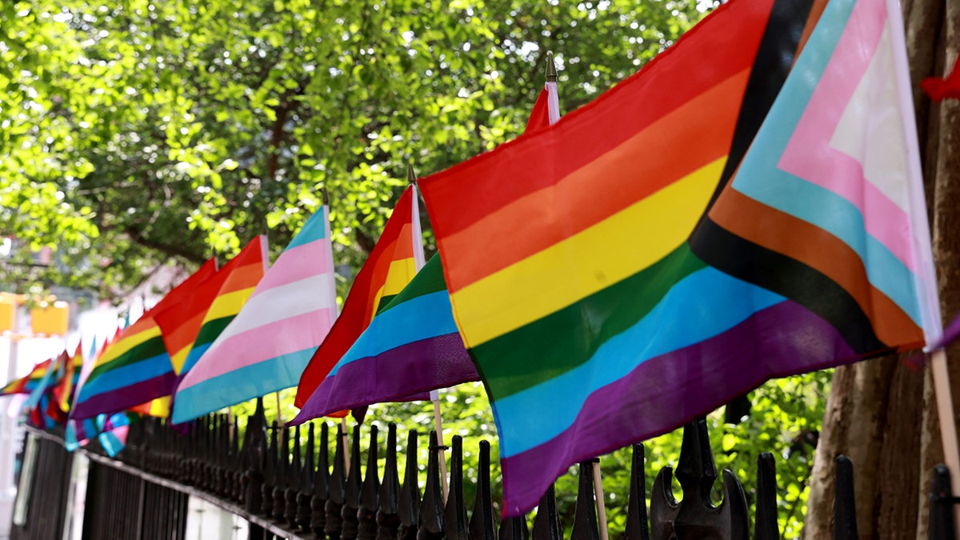
Father sues school district for refusing to display ‘straight pride’ flag alongside Progress Pride flag
A Colorado father is suing the state's largest school district, claiming staff refused to let him display a "straight pride" flag alongside the Progress Pride flags on view throughout his children's Denver school.

Slide 12
Christian parents complain after 11-year-old daughter forced to share bed with biological male on school trip

Slide 13
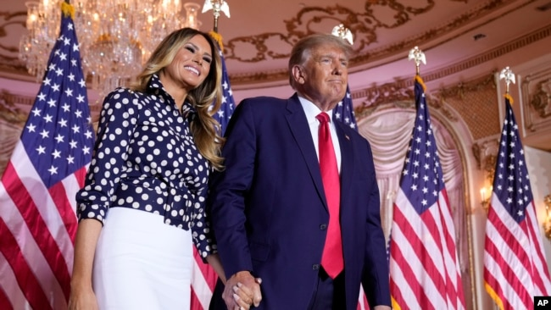
U.S. Political Division
Trump factor – fatigue and exhaustion
Trump’s very loyal base
Was reconsidering running then Mar a Lago raid and possible indictments, all but forced him to run
2024 race perspective
House investigations – major division and vitriol
Hunter Biden and Joe Biden
Atty General Merrick Garland
FBI Director Christopher Wray

Slide 14
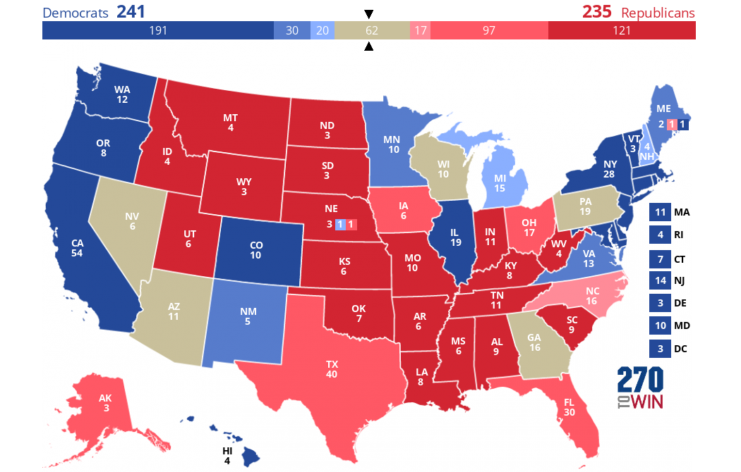
US Election November 2024

Slide 15
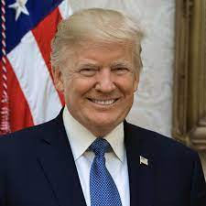
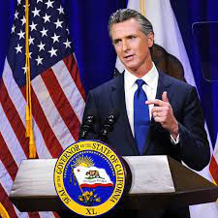
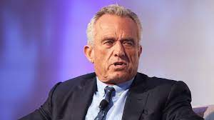
Republicans - Democrats - Independent
Republicans
Donald Trump
Ron Desantis
Nicki Haley
Glen Youngkin
Democrats
Gavin Newsom
Joe Biden
Independent
Robert F. Kennedy

Slide 16
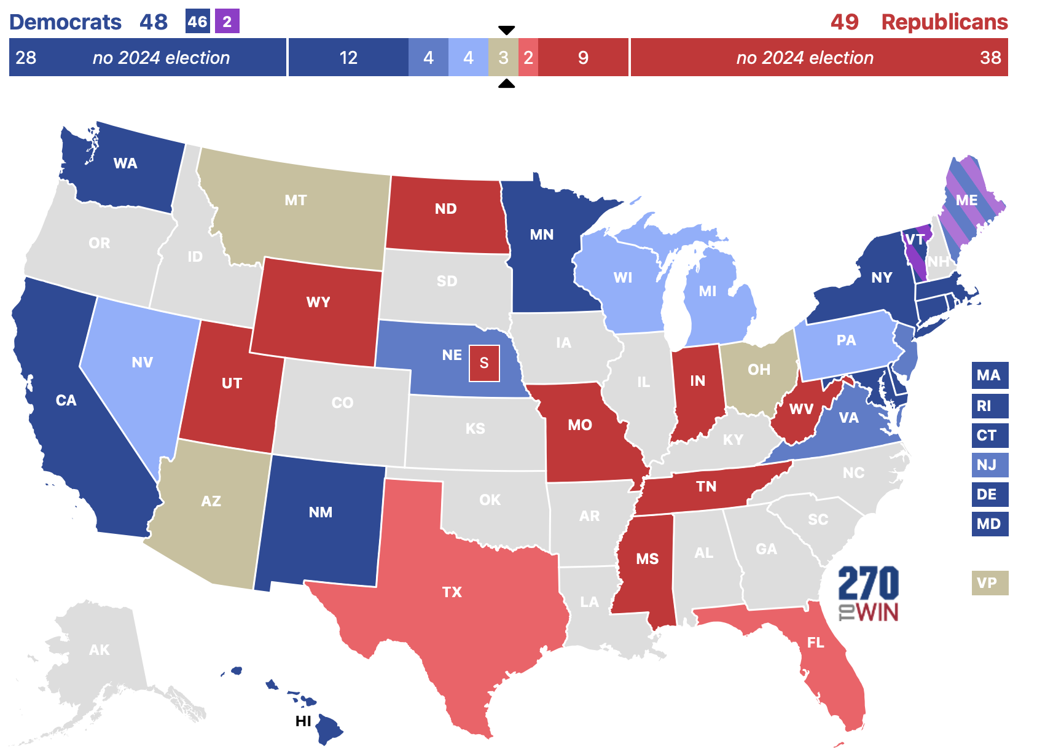
US Senate: 34 seats up in 2024 - including a special election in Nebraska - of which 23 are held by Democrats or Independents.
Republicans can retake control with a net gain of two seats or by winning the 2024 presidential election along with a net gain of one seat.

Slide 17
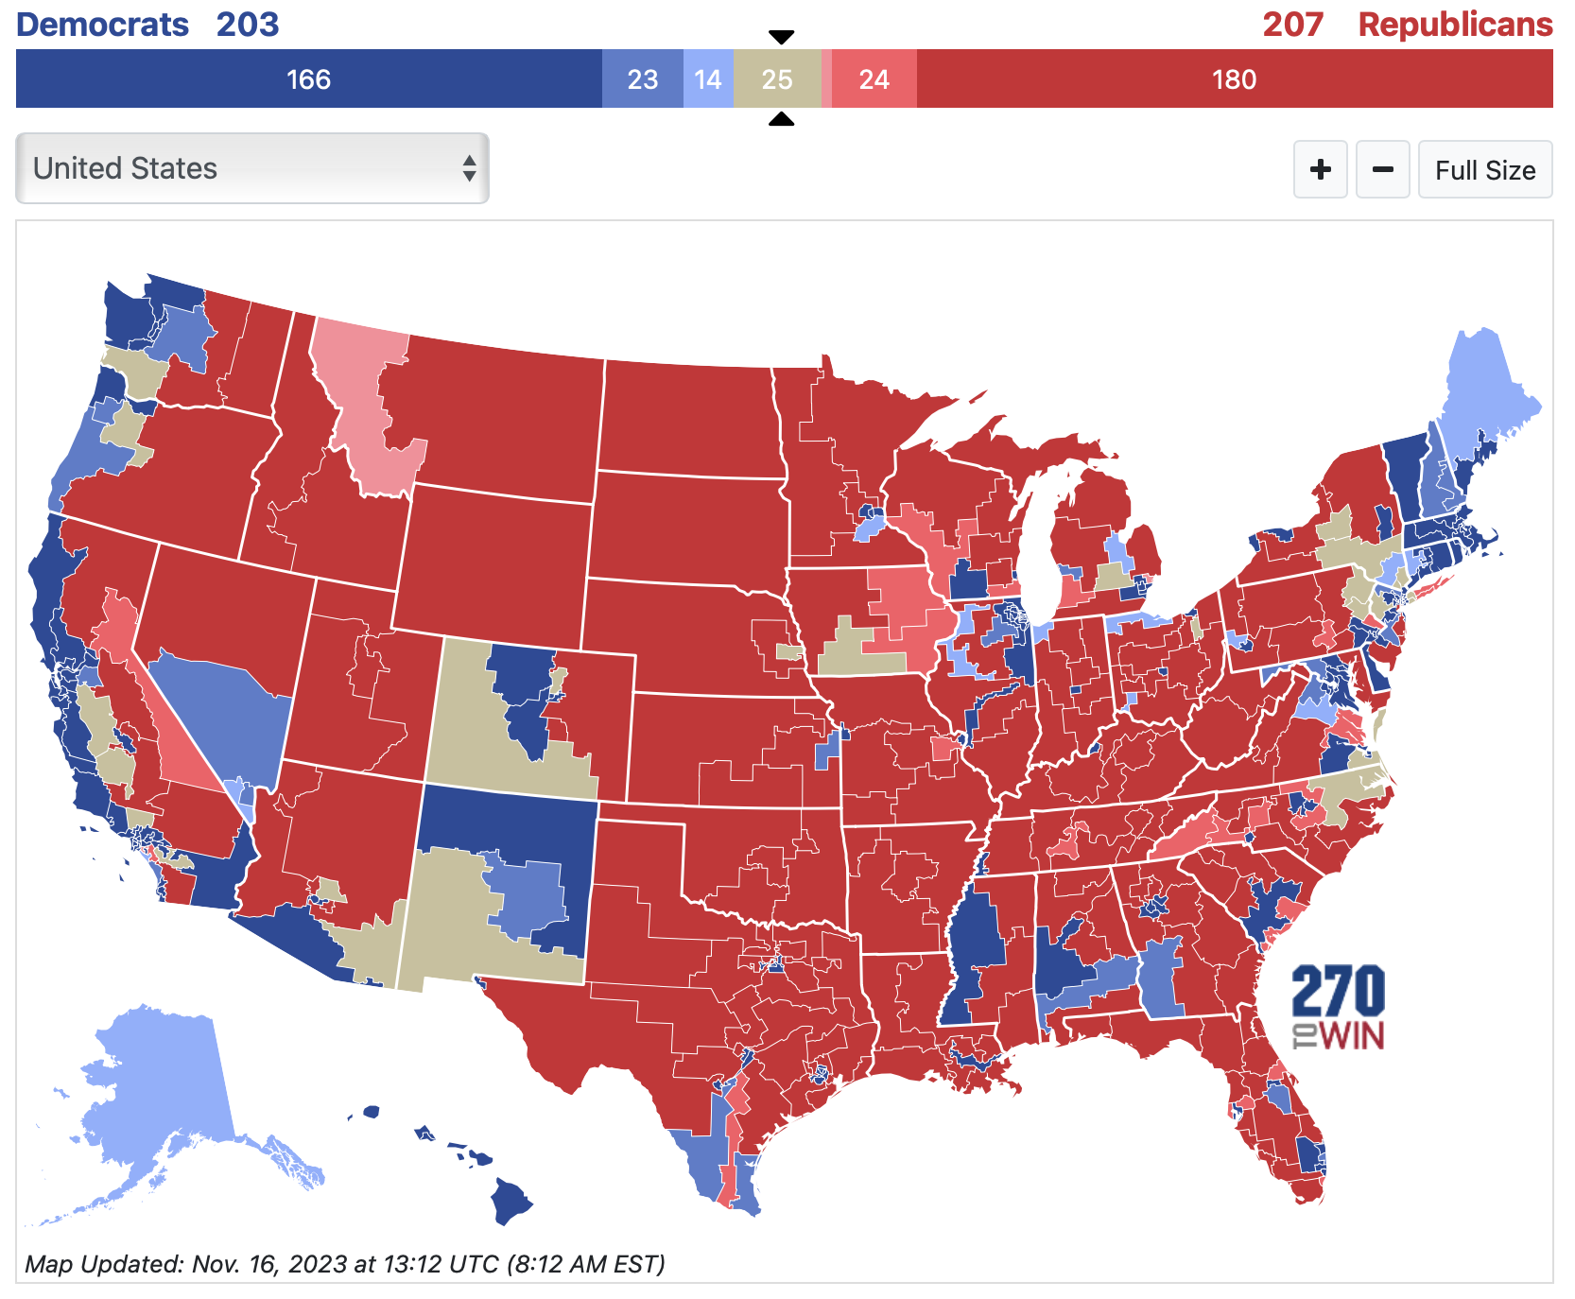
US House: 218 seats up in 2024
The Republican Party currently controls the U.S. House, where 218 seats are needed for a majority (when there are no vacancies).

Slide 18
USA Today, December 4, 2023 Could 2024 election cause society to collapse? Some preppers think so — and they're ready.
A growing number of people on both sides of the political divide who are preparing for the possibility of a disastrous collapse of society after the 2024 election. In the past 12 months, 39% of millennials and 40% of Gen Zers reported having spent money on prepping, according to Finder.com, which has collected similar data since at least 2017. Overall, almost 30% of Americans surveyed reported taking some steps toward emergency preparedness last year, up from about 25% in 2017, according to the annual Finder survey.

Slide 19
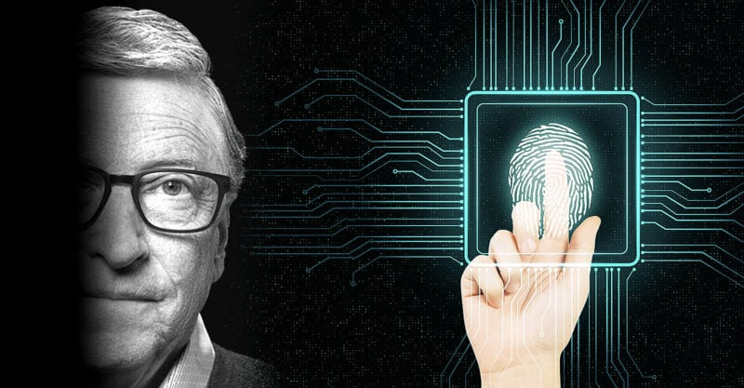
UN Launches Gates-Funded Global Digital ID Program as Experts Warn of ‘Totalitarian Nightmare’ December 1, 2023
With support from the Bill & Melinda Gates Foundation, the United Nations (U.N.) this month launched an “ambitious-country-led campaign” to promote and accelerate the development of a global digital public infrastructure (DPI).
The United Nations Development Programme (UNDP) said its “50-in-5” campaign will spur the construction of “an underlying network of components” that includes “digital payments, ID, and data exchange system,” which will serve as “a critical accelerator of the Sustainable Development Goals (SDGs).”
“The goal of the campaign is for 50 countries to have designed, implemented, and scaled at least one DPI component in a safe, inclusive, and interoperable manner in five years,” the UNDP stated.

Slide 20
Texas Sues Pfizer for ‘False’ and ‘Deceptive’ Marketing of COVID Vaccines
Texas Attorney General Ken Paxton on Thursday sued Pfizer alleging the drugmaker made “false, misleading and deceptive claims” about its COVID-19 vaccine and tried to intimidate and censor critics who questioned those claims or cited facts that countered them.
According to the lawsuit, Pfizer’s marketing claims about the efficacy, duration of protection and ability of its COVID-19 vaccine to prevent transmission violated the Texas Deceptive Trade Practices Act.
The lawsuit also alleges Pfizer cited misleading statistics, concealed negative data and made unsupported statements about efficacy against variants like Delta.

Slide 21
World Health Organization Sparks Concerns about Power Grab through Global Pandemic Treaty
Michele Bachmann: The World Health Organization or W.H.O. Through a series of 307 amendments and a global pandemic treaty, the W.H.O. is seeking to gain authority over international health decisions of U.N. member nations in the event of something like another COVID pandemic.
"Then they would be empowered to tell us in America we have to lock down, we have to shut down, we have to close our churches, we have to close our schools," Bachmann cautioned.
"We're forced – mandated – to take a vaccine, whether we want to or not. We're forced to mask.
We're forced to – whatever it is that they tell us – that we have to do.
We have never before in history – in five thousand years of recorded human history – we've never seen this level of authority given to an international, global body."

Slide 22
One World Order and Plandemic
And that no man might buy or sell, save he that had the mark,
or the name of the beast, or the number of his name. Here is wisdom. Let him that hath understanding count the number of the beast: for it is the number of a man; and his number is Six hundred threescore and six.
Revelation 13:17-18

Slide 23
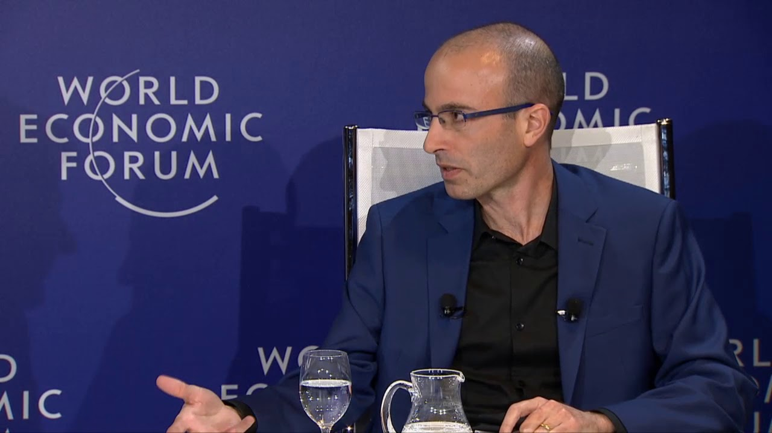
World Economic Forum - Harari
Historian Yuval Harari takes us on a journey through technological development and challenges leaders to develop a substantive vision of what it means for society, politics, religion and ideology.

Slide 24
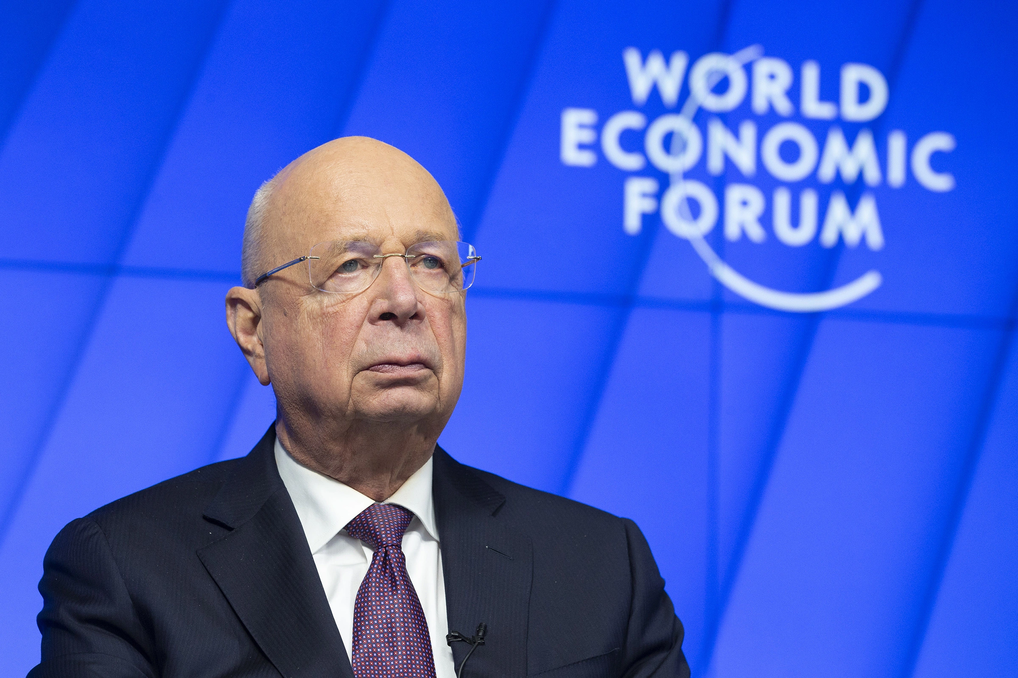
Klaus Schwab Explains How to Fix the Global Trust Crisis
We have over 50 initiatives, platforms for public-private cooperation. I’m very proud to say, since the beginning of the crisis, we have won over 200 additional partners who joined us without knowing when they could go to Davos or not.

Slide 25
But I think the time has come to bring people together, because we see a degradation of trust in the world, and trust only builds through personal relations. And the World Economic Forum, in a broader sense, is a community of multistakeholders, businesses, governments, civil societies, young generation, to work together.

Slide 28
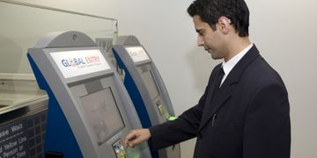
Facial Recognition is the Future
Global Entry facial recognition
No electronic boarding pass, no passport only a photo of a face
Driver license facial files
Convenience, security, ease of use and safety

Slide 29
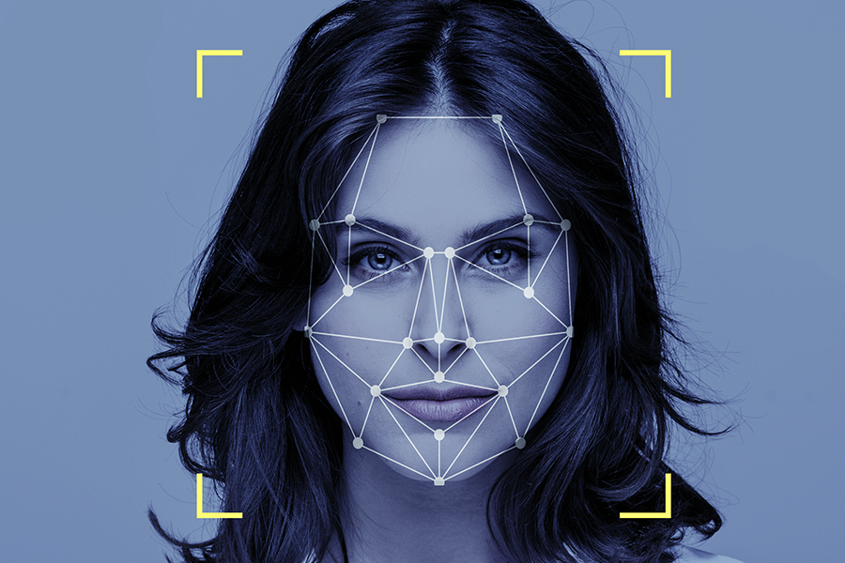
An optimized solution for face recognition
When artificial intelligence is tasked with visually identifying objects and faces, it assigns specific components of its network to face recognition — just like the human brain.

Slide 30
Truth and common sense under attack as well as Judeo-Christian values
Rebellion
Accusations
Hate speech vs. freedom of speech
Defiance
80 percent of college campuses
Christians are bigots, intolerant
Nut case thinking

Slide 32
Christian nationalism is Christianity-affiliated religious nationalism. Christian nationalists primarily focus on internal politics, such as passing laws that reflect their view of Christianity and its role in political and social life. In countries with a state Church, Christian nationalists, in seeking to preserve the status of a Christian state, uphold an antidisestablishmentarian position.

Slide 33
Christian nationalists support the presence of Christian symbols and statuary in the public square, as well as state patronage for the display of religion, such as school prayer and the exhibition of nativity scenes during Christmastide or the Christian Cross on Good Friday.

Slide 35
Christian Nationalism

Slide 36
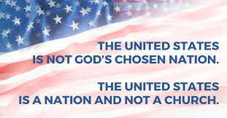
Phillips Theological Seminary

